Slide 1
WaiDATATHON - Challenge no.6
Personalizing profiles for an entertainment platform
Or how we mixed machine learning, business opportunities and added a value to a promising startup!
Notes:
Introduction from Joanna (?)

Slide 2
Overview of the project
The business
issue
The technical challenge
The solution
Expanding Entertwine’s business value proposition of user - user recommendations
🤝🏽
Figuring out the matching solutions with the given challenge
Building a user-recommendation model based on a given and legally acquired dataset
🛠️
Notes:
Joanna

Slide 3
Challenges
Adjusting the challenge to our skills, resources and timeframe
✍🏽
The ethical and legal side of the project
⚖️
Providing Entertwine with a working model that can benefit startup’s user experience.
👍🏽
Notes:
Joanna

Slide 4
Project process
Research
Phase
(iterated)
📚
Testing
Phase
(iterated)
♻️
Final
Tests
👩🏽‍💻
Notes:
Joanna

Slide 5
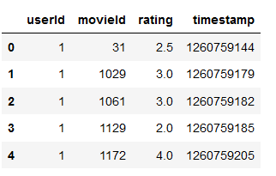
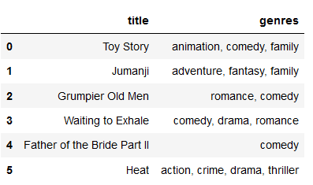
Dataset
Generated data
User data
Notes:
Akshaya + Karthika
(picture of the dataset)
Akshaya:

Slide 6
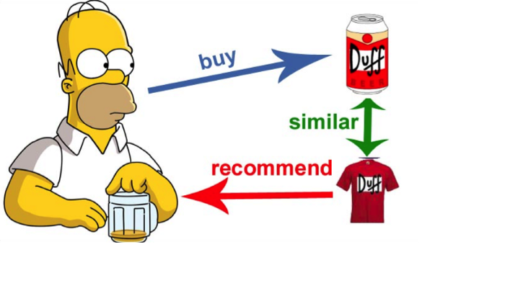
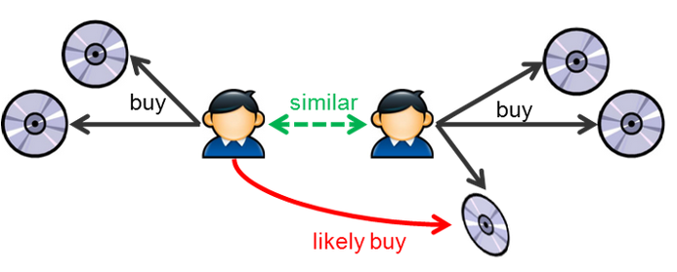
Recommendation methods
Content based
Collaborative based
Notes:
Akshaya + Karthika

Slide 7
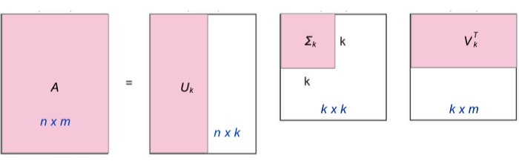
Collaborative based model - truncated SVD
Notes:
Akshaya + Karthika
https://towardsdatascience.com/intro-to-recommender-system-collaborative-filtering-64a238194a26

Slide 8
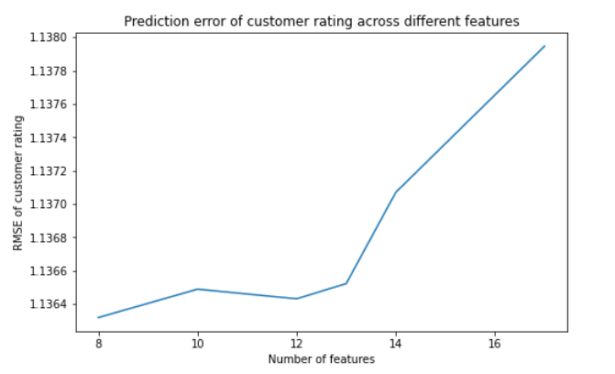
Collaborative based model - truncated SVD
Prediction accuracy
Challenge:
Handling missing values in training data (A- matrix)- finding the best hyperparameter rank ‘k’
Limitation:
Cold start problem
Notes:
Akshaya + Karthika

Slide 9
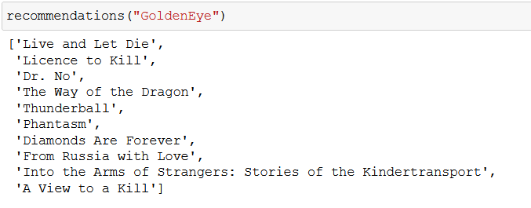
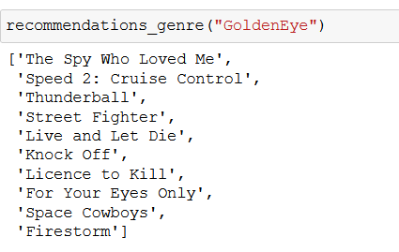
Content based model- similarity measure
Prediction
Limitation: Completely dependent on the description or genre
Notes:
Akshaya + Karthika

Slide 10
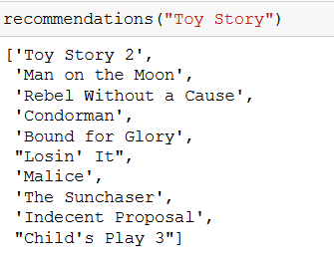


Content based model
Notes:
Akshaya + Karthika

Slide 11
Recommendations for future use
Using other rank factorization method to overcome the challenge of the SVD approach.
Using hybrid method to combine both content based and collaborative based
Notes:
Akshaya + Karthika

Slide 12
Takeaways
Get creative and treat the blockers not as obstacles but challenges!
Teamwork + diversity + great communication + googling skills = ❤️
Short project time can impact the future of the startup
Notes:
The whole team

Slide 13
Thank you!
Akshaya Ravi - Eindhoven, Netherlands
Karthika Kannan - Amsterdam, Netherlands
Joanna frota Kurkowska - Gdynia, Poland
Vertania Kemp - Maryland, U.S.A.
Kyiana Williams - California, U.S.A.

